Slide 1
A core Course on Modeling
Introduction to Modeling
0LAB0 0LBB0 0LCB0 0LDB0
c.w.a.m.v.overveld@tue.nl
v.a.j.borghuis@tue.nl
S.29

Slide 2
Execution: obtain result;
Reflection: interpret result
define
formulate
purpose
Right problem?
(problem validation)
conceptualize
identify
entities
choose
relations
Right concepts?
(concepts validation)
formalize
obtain
values
formalize
relations
Right model?
(model verification)
execute
operate
model
obtain
result
Right outcome?
(outcome verification)
Right answer?
(answer verification)
conclude
present
result
interpret
result
Notes:
2

Slide 3
Confidence for glass box models
Glass box models compute values for output quantities in dependency of input quantities.
For every purpose, defined in terms of output quantities, fulfilling the purpose means that the uncertainty distribution on the output quantities should be sufficiently small.
So we should know this uncertainty to know if the model result is OK.
http://cdn.morguefile.com/imageData/public/files/h/hotblack/preview/fldr_2008_11_02/file0001766655282.jpg
Notes:
3

Slide 4
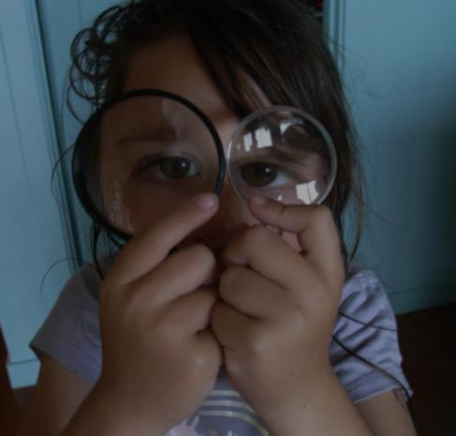
Confidence for glass box models (structural confidence)
1: examine dependencies in the functional network
http://www.morguefile.com/archive/display/695781
Notes:
4

Slide 5
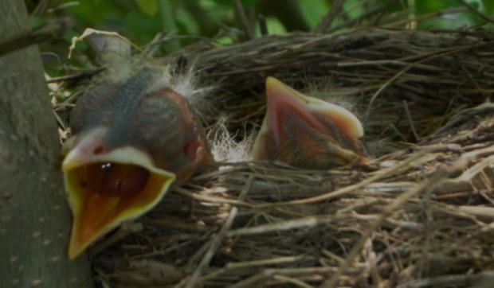
Confidence for glass box models (structural confidence)
1: examine dependencies in the functional network
expected
output
calculated
http://cdn.morguefile.com/imageData/public/files/t/taliesin/preview/fldr_2008_11_02/file0001331160119.jpg
input
input
output
select any pair of quantities, and graphically compare their dependency with what you expect, ...
Notes:
5

Slide 6
Confidence for glass box models (structural confidence)
QUIZ
How do you expect, in a taxi company, that the profit depends on the world gasoline price?
1: examine dependencies in the functional network
expected
output
calculated
http://cdn.morguefile.com/imageData/public/files/t/taliesin/preview/fldr_2008_11_02/file0001331160119.jpg
input
input
output
select any pair of quantities, and graphically compare their dependency with what you expect, ...
Notes:
6

Slide 7
Confidence for glass box models (structural confidence)
1: examine dependencies in the functional network
expected
output
calculated
http://cdn.morguefile.com/imageData/public/files/t/taliesin/preview/fldr_2008_11_02/file0001331160119.jpg
input
input
output
select any pair of quantities, and graphically compare their dependency with what you expect, ...
Notes:
7

Slide 8
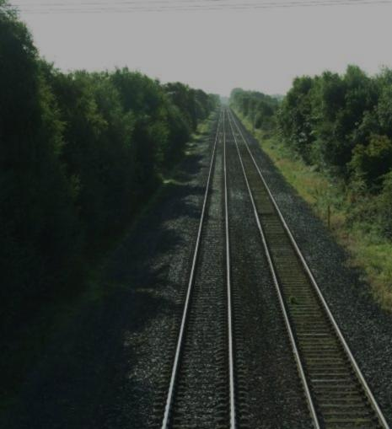
Confidence for glass box models (structural confidence)
1: examine dependencies in the functional network
expected
output
calculated
input
output
http://www.morguefile.com/archive/display/621362
input
... in particular if they involve multiple parallel routes ...
Notes:
8

Slide 9
Confidence for glass box models (structural confidence)
QUIZ
How do you expect, in a taxi company, that the profit depends on the km price charged?
1: examine dependencies in the functional network
expected
output
calculated
input
output
http://www.morguefile.com/archive/display/621362
input
... in particular if they involve multiple parallel routes ...
Notes:
9

Slide 10
Confidence for glass box models (structural confidence)
1: examine dependencies in the functional network
expected
output
calculated
input
output
http://www.morguefile.com/archive/display/621362
input
... in particular if they involve multiple parallel routes ...
Notes:
10

Slide 11
http://www.morguefile.com/archive/display/13201
Confidence for glass box models (structural confidence)
1: examine dependencies in the functional network
output
expected?
calculated?
input
output
... and if there is no dependency, there is no graph.
input
Notes:
11

Slide 12
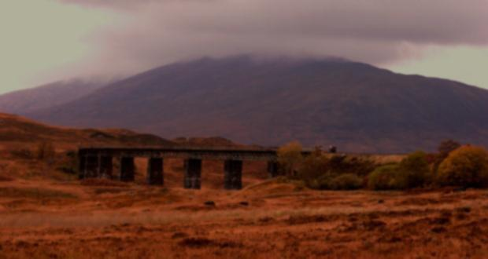
Confidence for glass box models (structural confidence)
1: examine dependencies in the functional network
2: examine if the long range behavior is correct
http://cdn.morguefile.com/imageData/public/files/h/hotblack/preview/fldr_2008_11_02/file0001143496830.jpg
Notes:
12

Slide 13
Confidence for glass box models (structural confidence)
1: examine dependencies in the functional network
2: examine if the long range behavior is correct
QUIZ
How do you expect, in the street lantern problem, that perceived intensity maxima and minima will be if lanterns get ∞ far apart?
http://cdn.morguefile.com/imageData/public/files/h/hotblack/preview/fldr_2008_11_02/file0001143496830.jpg
Notes:
13

Slide 14
Confidence for glass box models (structural confidence)
1: examine dependencies in the functional network
2: examine if the long range behavior is correct
http://cdn.morguefile.com/imageData/public/files/h/hotblack/preview/fldr_2008_11_02/file0001143496830.jpg
Notes:
14

Slide 15
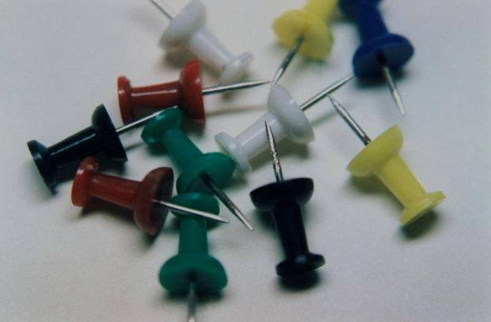
Confidence for glass box models (structural confidence)
1: examine dependencies in the functional network
2: examine if the long range behavior is correct
3: examine if singular behavior is correct
http://www.morguefile.com/archive/display/7280
Notes:
15

Slide 16
Confidence for glass box models (structural confidence)
1: examine dependencies in the functional network
2: examine if the long range behavior is correct
3: examine if singular behavior is correct
QUIZ
What do you expect to be the intensity right underneath a lantern?
http://www.morguefile.com/archive/display/7280
Notes:
16

Slide 17
Confidence for glass box models (structural confidence)
1: examine dependencies in the functional network
2: examine if the long range behavior is correct
3: examine if singular behavior is correct
http://www.morguefile.com/archive/display/7280
Notes:
17

Slide 18
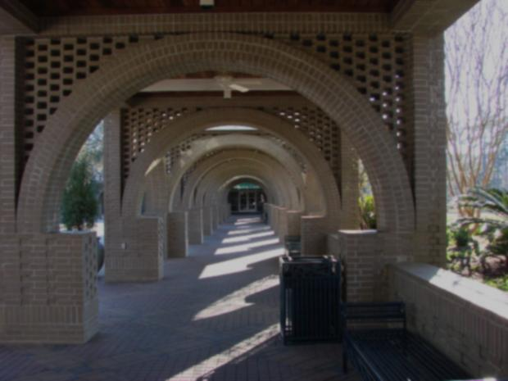
Confidence for glass box models (structural confidence)
1: examine dependencies in the functional network
2: examine if the long range behavior is correct
3: examine if singular behavior is correct
4: examine if things that should converge have converged
http://cdn.morguefile.com/imageData/public/files/m/mrmac04/preview/fldr_2008_11_28/file000131256114.jpg
Notes:
18

Slide 19
Confidence for glass box models (structural confidence)
1: examine dependencies in the functional network
2: examine if the long range behavior is correct
3: examine if singular behavior is correct
4: examine if things that should converge have converged
QUIZ
What happens, in the street lantern problem, with the intensity in some point r if the number of streetlamps increases?
http://cdn.morguefile.com/imageData/public/files/m/mrmac04/preview/fldr_2008_11_28/file000131256114.jpg
Notes:
19

Slide 20
Confidence for glass box models (structural confidence)
1: examine dependencies in the functional network
2: examine if the long range behavior is correct
3: examine if singular behavior is correct
4: examine if things that should converge have converged
http://cdn.morguefile.com/imageData/public/files/m/mrmac04/preview/fldr_2008_11_28/file000131256114.jpg
Notes:
20

Slide 21
Confidence for glass box models (structural confidence)
1: examine dependencies in the functional network
2: examine if the long range behavior is correct
3: examine if singular behavior is correct
4: examine if things that should converge have converged
QUIZ
Which of these four tests are validation and which are verification?
http://cdn.morguefile.com/imageData/public/files/m/mrmac04/preview/fldr_2008_11_28/file000131256114.jpg
Notes:
21

Slide 22
Confidence for glass box models (structural confidence)
1: examine dependencies in the functional network
2: examine if the long range behavior is correct
3: examine if singular behavior is correct
4: examine if things that should converge have converged
validation
validation
validation
http://cdn.morguefile.com/imageData/public/files/m/mrmac04/preview/fldr_2008_11_28/file000131256114.jpg
verification
Notes:
22

